Slide 1
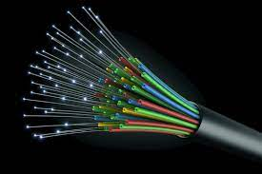
LOG DISTANCE / NORMAL SHADOWING PATHLOSS MODEL
GROUP NUMBER : 9
BATCH : S3 (CSE) AI A
GROUP MEMBERS:
Roll No Name of students
AM.EN.U4AIE20002 Abhinandhu A
AM.EN.U4AIE20035 Hariprasad S
AM.EN.U4AIE20045 M Mahadev
AM.EN.U4AIE20046 Maddala H S M Krishna Karthik
AM.EN.U4AIE20048 Marasani Jayasurya

Slide 2
Overview
Path loss models are a type of large-scale fading model that is used to calculate the power loss of a radio signal as it travels away from the transmitter.
The log-distance path loss model is a radio propagation model that estimates path loss inside buildings and densely populated areas over time.
The model includes random shadowing effects caused by signal obstructions such as hills, trees, and buildings. The log normal shadowing model is another name for it.

Slide 3
Objective
To implement log distance pathloss and log normal shadowing pathloss.
Implementation of the above model in MATLAB .
To plot the pathloss vs distance graph using both the models for various propagation environments like free space, shadowed urban cellular radio, obstructed in building or factory etc.

Slide 4
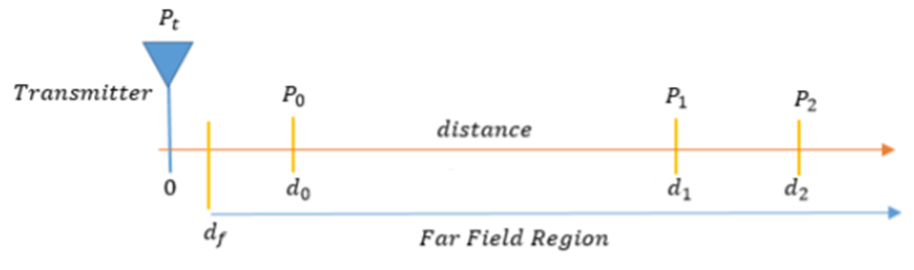
Block Diagram

Slide 5
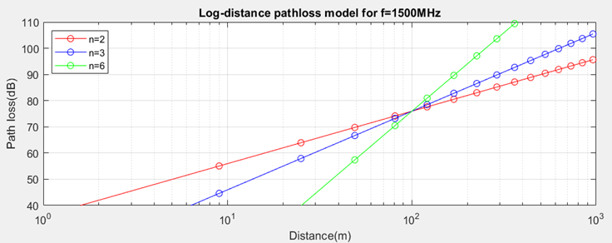
Simulation Results
For Log-distance pathloss model for f=1500 Hz

Slide 6
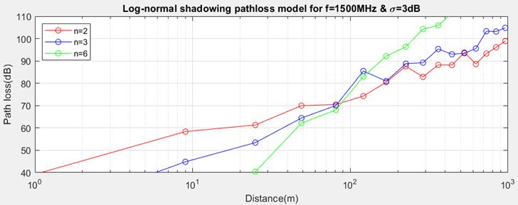
Contd.
For Log-normal shadowing pathloss model for f = 1500 Hz and 𝝈 = 3dB

Slide 7
Inference
From the above simulation Result
figure-I shows the received signal power when there is no shadowing effect and figure-II shows the received signal power when shadowing exists.
The results are generated with frequency of transmission f =1500MHz, reference distance d0 =100m, standard deviation of the log-normal shadowing 𝝈=3 dB for three different environments which has PLE n=2,3,6.
The distance d is taken as an array which contains squares of the first 30 odd numbers. The graphs are plotted by taking x-axis as the distance and y-axis as the path loss in decibels(dB).
The results clearly illustrate that the graph for the log distance pathloss model is just a straight line, whereas the log-normal shadowing model introduces randomness in the received signal power, putting us closer to reality.

Slide 8
Conclusion
Log distance pathloss and log normal shadowing pathloss models are implemented using MATLAB.
Pathloss vs Distance graphs are plotted using both the models for various propagation environments like free space, shadowed urban cellular radio, obstructed in building or factory etc.
From the above results it is clear that the graph is simply straight line for log distance pathloss and the graph is in randomness for log-normal shadowing model which is close to reality.

Slide 9
Reference
https://www.gaussianwaves.com/2013/09/log-distance-path-loss-or-log-normal-shadowing-model/
http://www.idc-online.com/technical_references/pdfs/electronic_engineering/Log_Distance_Path_Loss_or_Log_Normal_Shadowing_Model.pdf
https://en.wikipedia.org/wiki/Log-distance_path_loss_model

